Slide 1
Designing Materials to Revolutionize and Engineer our Future (DMREF) John Schlueter

Slide 2
Vision

Slide 3
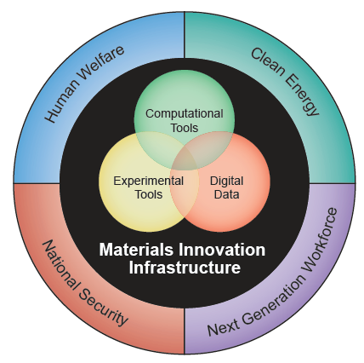
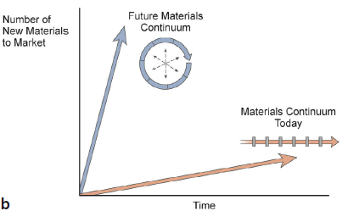
Materials Genome Initiative (MGI) Approach
Integrate materials discovery, development, property optimization, and systems design.
Integrate advanced computational methods and visual analytics with data-enabled scientific discovery.
NSF
DMR

Slide 4
Designing Materials to Revolutionize and Engineer our Future (DMREF)
NSF’s Response to and participation in the
Materials Genome Initiative
NSF is interested in activities that accelerate materials discovery and development by building the fundamental knowledge base needed to progress towards designing and making materials with specific and desired functions or properties from first principles.
The DMREF goal is to control material properties through design: this is to be accomplished by understanding the interrelationships of composition, processing, structure, properties, performance, and process control.

Slide 5
Goals
Lead a culture shift in materials science research to encourage and facilitate an integrated team approach.
Synergistically integrate experiment, computation, and theory and equip the materials community with advanced tools and techniques.
Design and make materials with specific and desired functions or properties from first principles.
Integrate digital data, software, and program outputs into community.
Create a world-class materials science and engineering workforce that is trained for careers in academia or industry.

Slide 6
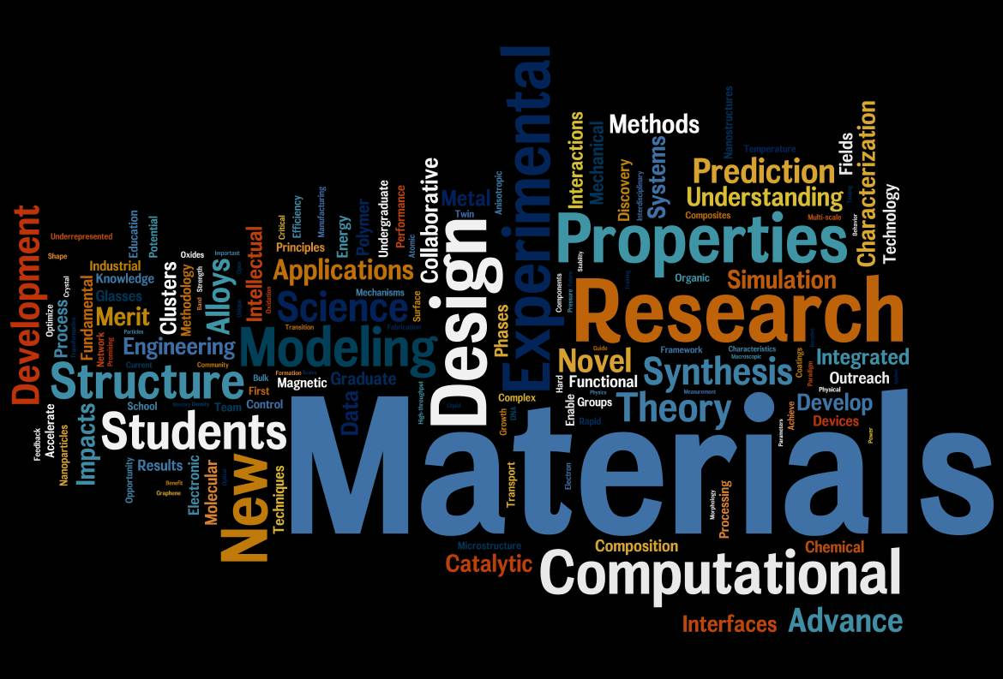
Program Scope
Proposals from multidisciplinary teams
Chemistry Computer Science Materials Science
Physics Engineering Mathematics
Covers all material classes
Electronic
Photonic
Molecular
Biomaterials
Polymers
Magnetic
Ceramic
Metals
Alloys
Catalytic
Energy
Composites
Nano

Slide 7
Coordination of Programs
Division of Materials Research
BMAT CER EPM
CMP CMMT MMN
POL SSMC
National Science Foundation
MPS: CHE, DMR, DMS
ENG: CBET, CMMI, ECCS
CISE: ACI, CCF, CNS, IIS
Other Agencies
DOE, NIST, DOD, NASA, NIH, USGS

Slide 8
Funding for DMREF
Funding has increased over DMREF lifetime.
More divisions have participated.
DMR continues to play the lead role.
Increased commitments from MPS divisions in FY16.
*‘Other’ funding from directorates is from GOALI & OMA.

Slide 9
DMREF Solicitation
 | FY15 | FY16
Solicitation # | 14-591 | 15-608
Window | Jan 5-29 | Jan 4-19
Duration | 3-4 years | 3-4 years
Size | $0.5 – 1.5 M | $0.75 – 1.6 M
Est. # awards | 18-25 | 20-25
Anticipated funds | $22 M | $29.75 M
PIs indicate primary division with which most closely aligned.
Management Team makes final decision of ownership
Secondary divisions may be chosen
Must be collaborative
Minimum of 2 PIs (3-5 typical)
Single- or multi-institution
An individual can be a PI on only one DMREF proposal per window
GOALI proposals may be submitted.

Slide 10
DMREF Review Criteria
Intellectual Merit
Broader Impact
Does the proposed research use collaborative processes with iterative feedback between tasks?
Is the proposed work likely to lead to significant advances in all components of the project, including materials synthesis/growth/processing, materials characterization/testing, and theory/computation/simulations?
Does the proposed work help accelerate materials discovery and development by building the fundamental knowledge base needed to progress toward designing and making materials with specific, desired functions or properties?
Does the proposed work provide access to its outputs, including publications, software, and data, with clear identification of what license(s) will be used?

Slide 11
Mathematics and Computer Science
PIs are encouraged to include these components if they strengthen the proposal.
Special instructions exist for PIs selecting Division of Mathematical Sciences (DMS) or Advanced Cyberinfrastructure (ACI).
PIs interested in selecting DMS or ACI as the primary unit of consideration are strongly encouraged to confer with the DMS and ACI Program Director prior to submission.

Slide 12
Collaboration
The complexity and challenge of activities addressed by this initiative require a transformative approach to discovering and developing new materials, predicting and optimizing properties of materials, and informing the design of material systems. Accordingly, the proposed research must be a collaborative and iterative process wherein theory guides computational simulation, computational simulation guides experiments, and experiments further guide theory.
Proposals MUST be represent collaborative research.
A minimum of two PIs or co-PIs is required.
*It is not required that proposals be “Collaborative Proposals” as described in the GPG Section II.D.4. The collaborating PIs/co-PIs may be from the same institution, or they may be from different institutions submitting a Collaborative Proposal under GPG Section II.D.4.

Slide 13
The ‘Iterative Feedback Loop’
“Traditional” approach is linear.
Synthesis
Processing
Property
Experiment
Theory
Simulation
“Closing the loop” must advance or accelerate materials design.
Synthesis
Processing
Property
Measurement
Theory
Simulation
Synthesis, Measurement must guide each other in an iterative fashion.

Slide 14
Limit on Submissions per PI
No individual may appear as Senior Personnel (PI, Co-PI, Faculty or Other Senior Associate) on more than one DMREF proposal submitted in response to this solicitation.
If any individual appears as Senior Personnel on more than one DMREF proposal, only the first proposal received from that individual will be reviewed.
Current awards or pending proposals submitted to other NSF programs do not preclude submission to the January 2016 DMREF window.
You may be a PI or co-PI on only ONE DMREF proposal for the January 2016 window. PIs with current DMREF awards may apply.

Slide 15
Open Access to Data and Codes
All NSF proposals must have a data management plan; this is not likely to suffice for DMREF proposals
Data and codes must be not only available, but accessible, ideally by researchers whom you will not meet
Support for software engineers, database programmers, or other individuals is allowable in DMREF budgets
Data and codes must be accessible to the broad materials community. Many databases and repositories exist for materials data and codes, and
we anticipate some proposals to create new ones as well.

Slide 16
Representative DMREF-DMR Topics (Hard Materials)
High pressure synthesis of oxynitride photocatalysis
High temperature alloys
Spintronic materials
5d transition metal complexes
Dielectric/metallic heterostructures
Thermoelectrics
Interfaces of correlated materials
Topological insulators
Metallic glasses
2D metal dichalcogenides
Nitride-based wide-bandgap semiconductors
Magneto-electronic complex fluoride interfaces
Sodium ion conductors
Superhard BCN materials
Superconductors / magnetic semiconductors

Slide 17
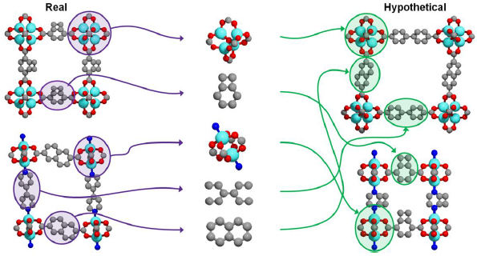
Representative DMREF-DMR Topics (Soft Materials)
DNA nanostructures
Acoustic polymers
Chemo-responsive liquid crystals
Graphene origami
Mobility in conjugated polymers
All-organic light emitting diodes
Organic solar cells
Multi-block polymer nanostructures
MOF catalysts
Organic glasses
Peptide hybrid materials
Helical protein assemblies
Hydroxide transport in polymers
Molecular electronic materials
Chemomechanical materials

Slide 18
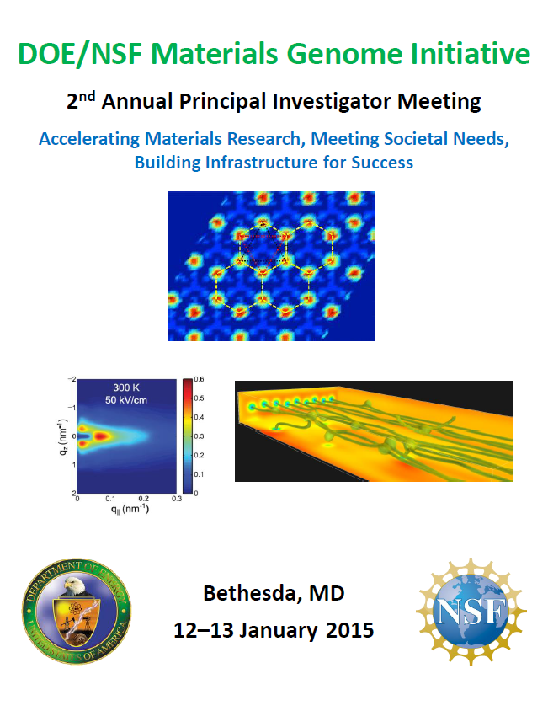
Proceedings from Annual PI Meetings
www.orau.gov/mgi2015/abstractbook.htm

