Slide 1

Synthetic materials with attributes of neural tissue
Seth Fraden
Brandeis University Award #1534890
Neural tissue evolved 3.5 billion years after the origin of life, which is a testament to its complexity, and is found in almost all multicellular life, which is a testament to its importance. At the coarsest level of description, neurons are non-linear oscillators that when coupled together in tissue through excitatory and inhibitory connections give rise to complex spatio-temporal patterns that control musculature. Extrapolating from this general definition of a neuronal network, we reproduced the dynamics that produce the swimming of an eel on an abiologic reaction-diffusion platform. We employ the well-known oscillatory Belousov-Zhabotinsky reaction, coupled with advances in soft lithography that allow the engineering of synthetic reaction-diffusion networks over which we design (i) the topology of the network, the (ii) boundary and (iii) initial conditions, (iv) the volume of each reactor, (v) the coupling strength, and (vi) whether the coupling is of an inhibitory or excitatory nature. It is important to note that the engineering principles we identify are general and can be applied to other oscillatory reaction-diffusion systems. This work required the integrated efforts of experimentalists and theorists to design, construct and characterize the materials.
T. Litschel, M. M. Norton, V. Tserunyan and S. Fraden, Lab on a Chip 18, 714 - 722, (2018).
Notes:
Our DMREF supported work was selected for the cover of Lab Chip and as a HOT article, a designation reserved for papers that received particularly high scores at peer review. http://pubs.rsc.org/en/journals/articlecollectionlanding?sercode=lc&themeid=963675ba-d61c-4ed1-915c-5cd80011bbfb.
Consider the mesmerizing sinuous motion of a swimming blue eel illustrated in this video: https://youtu.be/RgJCxN3ShbY. The motion is coordinated, smooth and somehow, it’s obvious to any observer that the eel is a living organism. The fact that no would mistake an eel for an inanimate object raises a series of questions. Why is there such a void between the animate and inanimate that we never confuse the two? Can engineers create materials with similar attributes to living organisms, but constructed from inanimate objects, and can we do so in the same manner as the living by using only chemicals and eschew use of motors and electronics? This latter challenge, being addressed by researchers in the new field of Soft Robotics, motivates the lab of Seth Fraden at Brandeis University, whose research is sponsored by NSF’s Designing Materials to Revolutionize and Engineer the Future (DMREF).
Biologists studying the swimming eel revealed that the sinuous motion is the result of an autonomous neural network, named the Central Pattern Generator (CPG), which produces waves of chemical pulses that propagate down the spine, alternating sequentially from side to side. These pulses in turn enervate musculature that actuates the swimming motion. Thus, inspired by the successful design architecture of the eel, Fraden’s lab divides the engineering challenge in two parts; first construct a control device that produces the same spatio-temporal activation pattern of the CPG and then subsequently build the actuation sub-system, with the former emulating the neural network and the latter the musculature. In their paper, “Engineering reaction–diffusion networks with properties of neural tissue,” that recently appeared on the cover of the journal Lab on a Chip, they solely focus on creating a control system that runs on chemical power, as is done in biology, without resorting to any computer or electromechanical devices, which are the hallmarks of manmade, hard robotic technology.
Neural tissue evolved 3.5 billion years after the origin of life, which is a testament to its complexity, and is found in almost all multicellular life, which is a testament to its importance. At the coarsest level of description, neurons are non-linear oscillators that when coupled together in tissue through excitatory and inhibitory connections give rise to complex spatio-temporal patterns. When organized, these patterns are capable of processing and storing sensory information, and actuating musculature. Extrapolating from this general definition of a neuronal network as a spatiotemporal pattern generator, the Fraden lab demonstrated that the same dynamics can be captured on an abiologic reaction–diffusion platform. They developed soft lithographic methods that allow the engineering of synthetic reaction–diffusion networks capable of producing a wide variety of spatiotemporal patterns. They employed the well-known oscillatory Belousov–Zhabotinsky (BZ) reaction and used their lithographic methods to create diffusively coupled networks over which they designed (i) the topology of the network, the (ii) boundary and (iii) initial conditions, (iv) the volume of each reactor, (v) the coupling strength, and (vi) whether the coupling is of an inhibitory or excitatory nature. Their robust chemical networks produced spatio-temporal patterns identical to the eel’s Central Pattern Generator. It is important to note that the engineering principles they identified are general and can be applied to design a whole range of other Central Pattern Generators, such as those responsible for other autonomous functions, such as the gaits of a horse, e.g. walk, canter, trot and gallop. The next challenge will be transferring the information coded in the dynamical spatiotemporal patterns of compartmentalized chemical reactors into a targeted mechanical response by coupling the central pattern generator they recently demonstrated to chemomechanical gels that contract in concert with the BZ reaction.

Slide 2
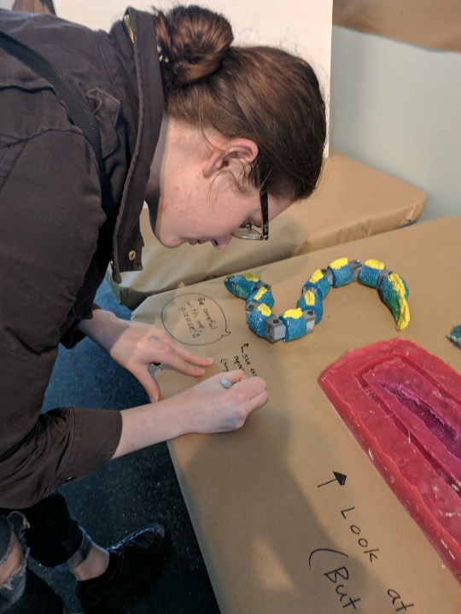
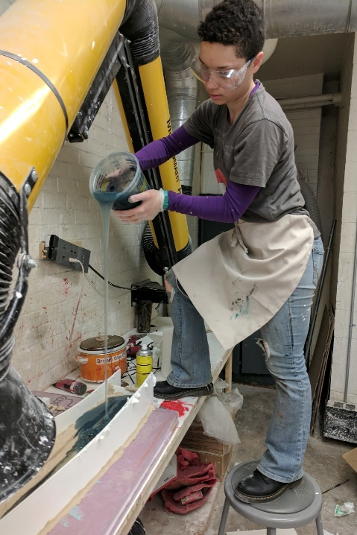
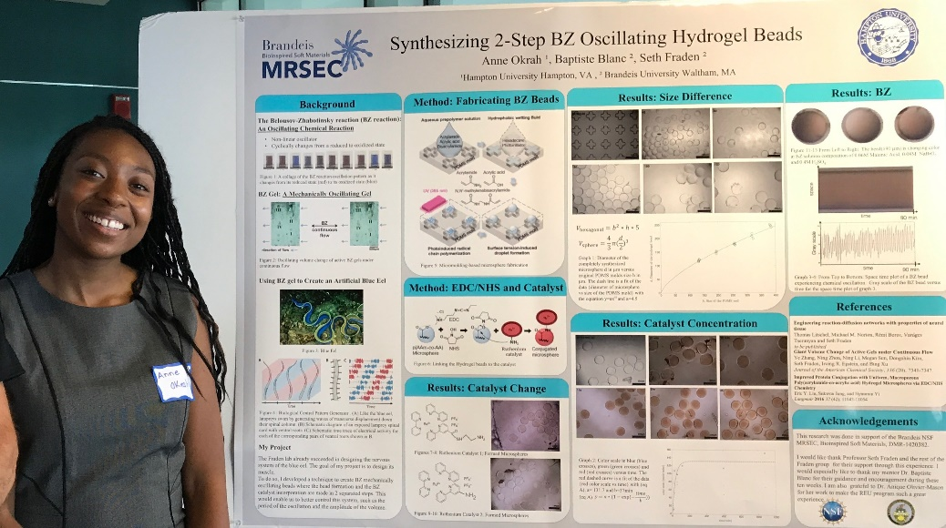
Undergraduate Art and Research
Seth Fraden
Brandeis University Award #1534890
(a)
(b)
Figures (a, b). The objective of DMREF: Programmable Chemomechanical Materials, is to develop purely synthetic, chemomechanical materials that emulate biological processes, such as the swimming of an eel. To communicate this objective, we teamed art majors with undergraduate researchers. Science and Art are both creative enterprises that utilize abstraction and idealization in order to represent reality. Over the course of a semester, a team of 4 art and DMREF students designed and constructed an installation for the annual Brandeis Arts Festival, May 2017 that conveyed the concept of a Central Pattern Generator, the mechanism by which the autonomous nervous system controls swimming.
(c)
Figure (c). Anne Okrah, a Chemical Engineering major from Hampton University, a HBCU, spent the summer of 2017 developing chemomechanical gels, which will serve as the “musculature” of the Central Pattern Generators in the art project described above. In a 2-step process, Ms. Okrah first manufactured uniform spherical of different diameters and subsequently functionalized them with catalyst.
Notes:
Please enter additional notes describing the context and success of the broader impacts of this award.

