Slide 1
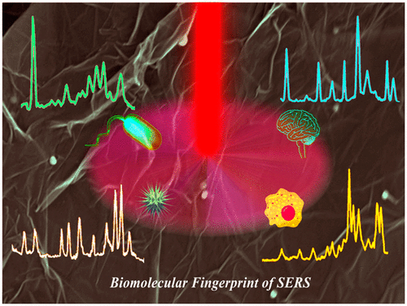
3D Nanoarchitecture for Bio-molecular Fingerprinting
DMR 1205194
We have developed three-dimensional (3D) nanoachitecture based surface enhnaced Raman spectroscopy (SERS) technology and demonstrated that it can be used for the diagnosis of bacteria, virus, Alzheimer’s disease biomarkers, cancer, explosives and toxic chemicals.
Our 3D technology has the capability to identify bacteria/virus/cancer cells in less than 10 cells/mL level.
Reported data show that 3D SERS has the capability to take environmental and medical diagnose technology to the next level.
Published in Acc. Chem. Res., 2016, 49, 2725–2735
Paresh C. Ray, Jackson State University
Please insert one or more images here. If you need more space, you may reduce the adjacent textbox. Please use lettering that is not too small. You could also insert chemical or mathematical formulas, molecular models, etc. Visually appealing images that can be appreciated by non-experts are most desirable, but feel free to use whatever is appropriate. Please include a very brief caption for the figures.
Very Important: Federal regulations require entering also “Alternative Text” for each image or other object to make them accessible to people with visual disabilities. Please see instructions on attached file for how to do that.

Slide 2
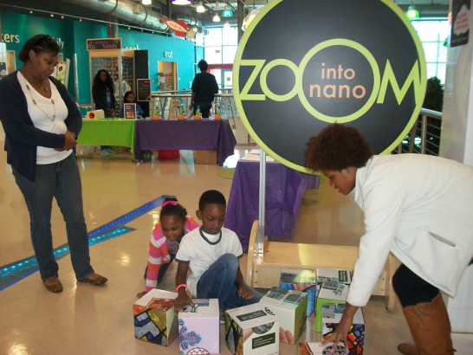
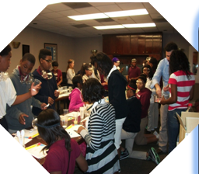
Outreach in Mississippi Children Museum on Visualizing the Wonder of nanotechnology
DMR 1205194
Paresh C. Ray, Jackson State University
NSF-JSU-UCSB PREM members are committed to conduct outreach activities at Mississippi Children's Museum to initiate a Science Line program to help local science students in their mission of enhancing scientific literacy to wider audiences.
A one-day event was conducted at Mississippi children museum in Jackson, MS. PREM members discussed how the society is already using some of the technologies. More than 500 participants joined in this activity to visualize the wonder of nanotechnology.
Please insert an image or group of images here to illustrate some of your broader impacts and activities in the current year. If you need more space, you may reduce the adjacent textbox. Please use lettering that is not too small and include also a figure caption.
Very Important: Federal regulations require entering also “Alternative Text” for each image or other object to make them accessible to people with visual disabilities. Please see instructions on attached file for how to do that.

