Slide 1
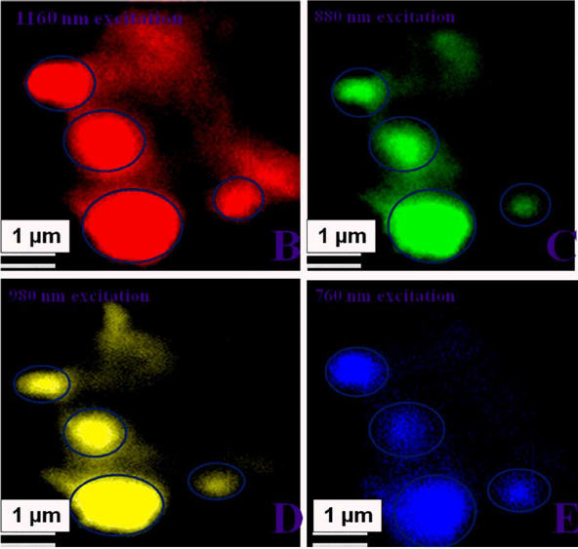
Graphene Oxide Can Pick and Image MRSA Paresh Ray (Jackson State University), DMR-Award # 1205194
The evolvement of multiple drug resistance MRSA bacteria has increased day by day and are spread all over the world. Early diagnosis is the key for survival from MRSA infection.
Our report demonstrated that graphene oxide can be used for highly selective multi-color bio-imaging of MDRB.
Our data indicate that graphene oxide based two-photon photoluminescence can be a good choice for multicolor bio-imaging applications.
Published in Scientific Reports (Nature Group Publication) 2014, 4, 6090, doi:10.1038/srep06090

