Slide 1
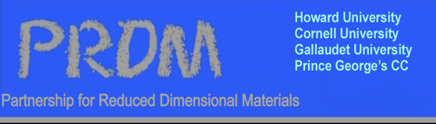
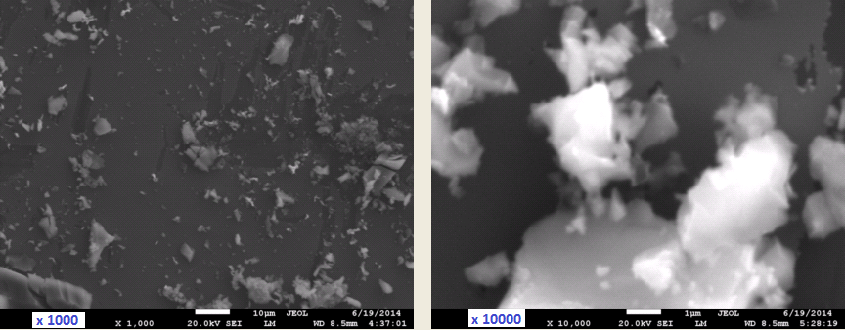
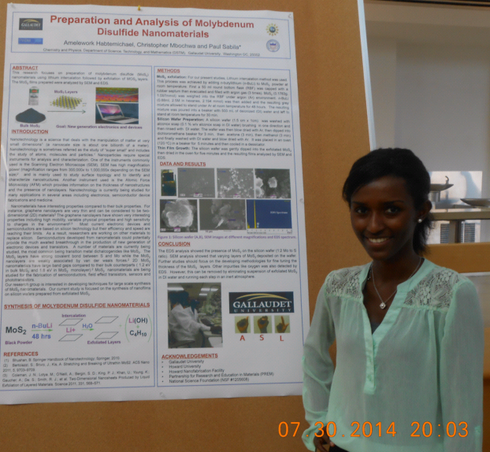
Nanotechnology at Gallaudet University: Exfoliation of MoS ₂ Paul S. Sabila, Amelework Habitemichael Gallaudet University Washington, DC
Supported by DMR-1205608
Overview: A team from Gallaudet University is working on nanotechnology projects including synthesis and characterization of MoS₂ films. We are generally interested in new strategies for preparing thin films and nanofilms of nanomaterials that exhibit interesting electronic properties. In the current study, MoS₂ films between 25-150 nm thickness were deposited on silicon wafers.
Impact/Benefits: We used chemical exfoliation to prepare and deposit thin films of MoS₂ on silicon wafers and characterized the deposited films using SEM, EDS and a profilometer.
The research work was widely disseminated within Gallaudet and reached the deaf community. The student intern gave a well received presentation to the Gallaudet University Board of Directors. Moreover the inclusion of Deaf and Hard of Hearing interns contributes to cultural enrichment for hearing students, faculty and staff in the PRDM program.
SEM images of deposited MoS₂ films at x1000 and at x10000 magnification.
Ms. Habtemichael a deaf student, using ASL to present her research at Gallaudet University.
Notes:
For further information contact: Prof. Paul S. Sabila, DSTM Department, Chemistry and Physics Program, Gallaudet University, Washington, DC paul.sabila@gallaudet.edu
Students have been recruited to participate in summer research at Howard. This is a unique opportunity to bring deaf and hard-of-hearing students into the laboratory and prepare them with critical research skills to help prepare them for a competitive job market or graduate school. The interaction of the deaf students with hearing students and faculty in the PRDM has provided an opportunity to educate all involved. In Summer 2015 Gallaudet students are presenting a number of lectures about ASL to all PRDM students and faculty.
Prof. Sabila, has integrated nanotechnology into chemistry courses at Gallaudet. Students research and prepare a presentation on nanotechnology related topics. Video presentations are done in American Sign Language (ASL).

