Slide 1
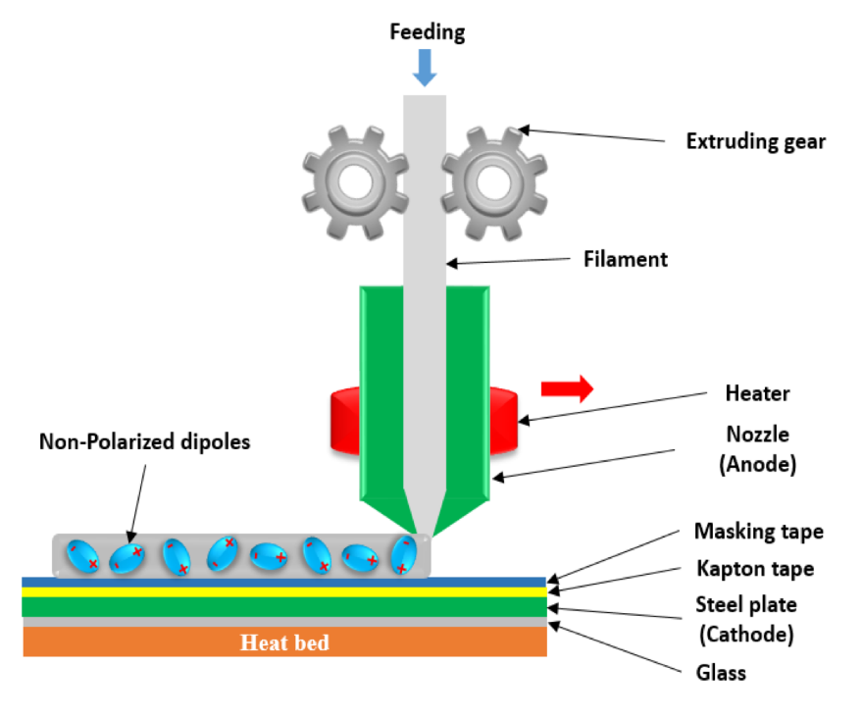
Integrated 3D printing with in-situ functionalization of piezoelectric nanocomposites Yirong Lin (University of Texas at El Paso), DMR-1205302
Our research supported by the NSF PREM project studied the synthesis, fabrication, and characterization of advanced materials for sensing, energy harvesting, and storage.
Our integrated 3D printing with in-situ functionalization of piezoelectric nanocomposite enabled us design nanocomposites with engineered properties towards different applications such as pressure sensing, self-cleaning, steam harvesting, vibration and thermal energy harvesting. Our research results generated 5 journal (1 accepted, 4 under review) papers this reporting period, and 1 proposal funded by DOE.
Figure: Schematic view of 3D printing with in-situ functionalization of nanocomposites
Notes:
NOTES

