Slide 1
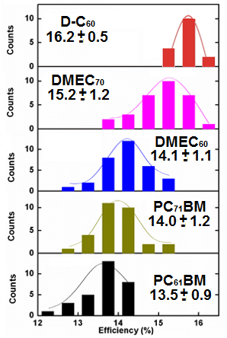
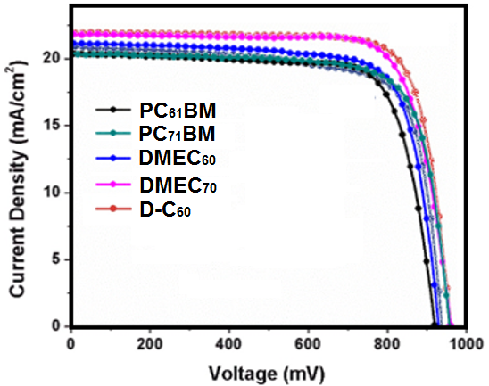
New Fullerene Derivatives for Electron Transporting Materials in Inverted Planar Perovskite Solar Cells Luis A. Echegoyen (University of Texas at El Paso), DMR-1205302
Perovskite solar cells (PSCs), have shown a remarkable increase in photoconversion efficiency (PCE), from 3.8% in 2009, to 22.1% in 2016. The good electron transporting and solution processable properties of most fullerene derivatives make them the most popular electron transporting materials (ETMs) in PSCs. To the best of our knowledge, the influence of different adducts on the PCEs of fullerene-based PSCs has not been fully explored to date. Here, we report new functionalized fullerene derivatives, and their performance as the ETMs in PSCs.
Fullerene Derivatives
J-V curves
Efficiencies
Notes:
NOTES

