Slide 1
Building Your Pipeline – Strategies for Recruiting and Keeping Students Engaged in PREM UTPA-UMN PREM
Directors Meeting
Division of Materials Research
National Science Foundation
Karen Lozano Ph.D., Arturo A. Fuentes Ph.D.
UTPA
October 26, 2011
Notes:
Good afternoon,
As mentioned, I will be presenting about some of our strategies for recruiting students and keeping them engaged in PREM.

Slide 2
PREM Student Recruitment & Engagement Key Activities
Background information
Student recruitment activities
Student research experiences & research seminar at UTPA
UTPA - REU participants and Faculty-Student Teams at UMN, & UTPA faculty and student visits to UMN Industrial Consortium (IPRIME)
UTPA-UMN joint research symposium, poster sessions, seminar speakers, webcast seminars at UTPA
Student involvement in outreach activities

Slide 3
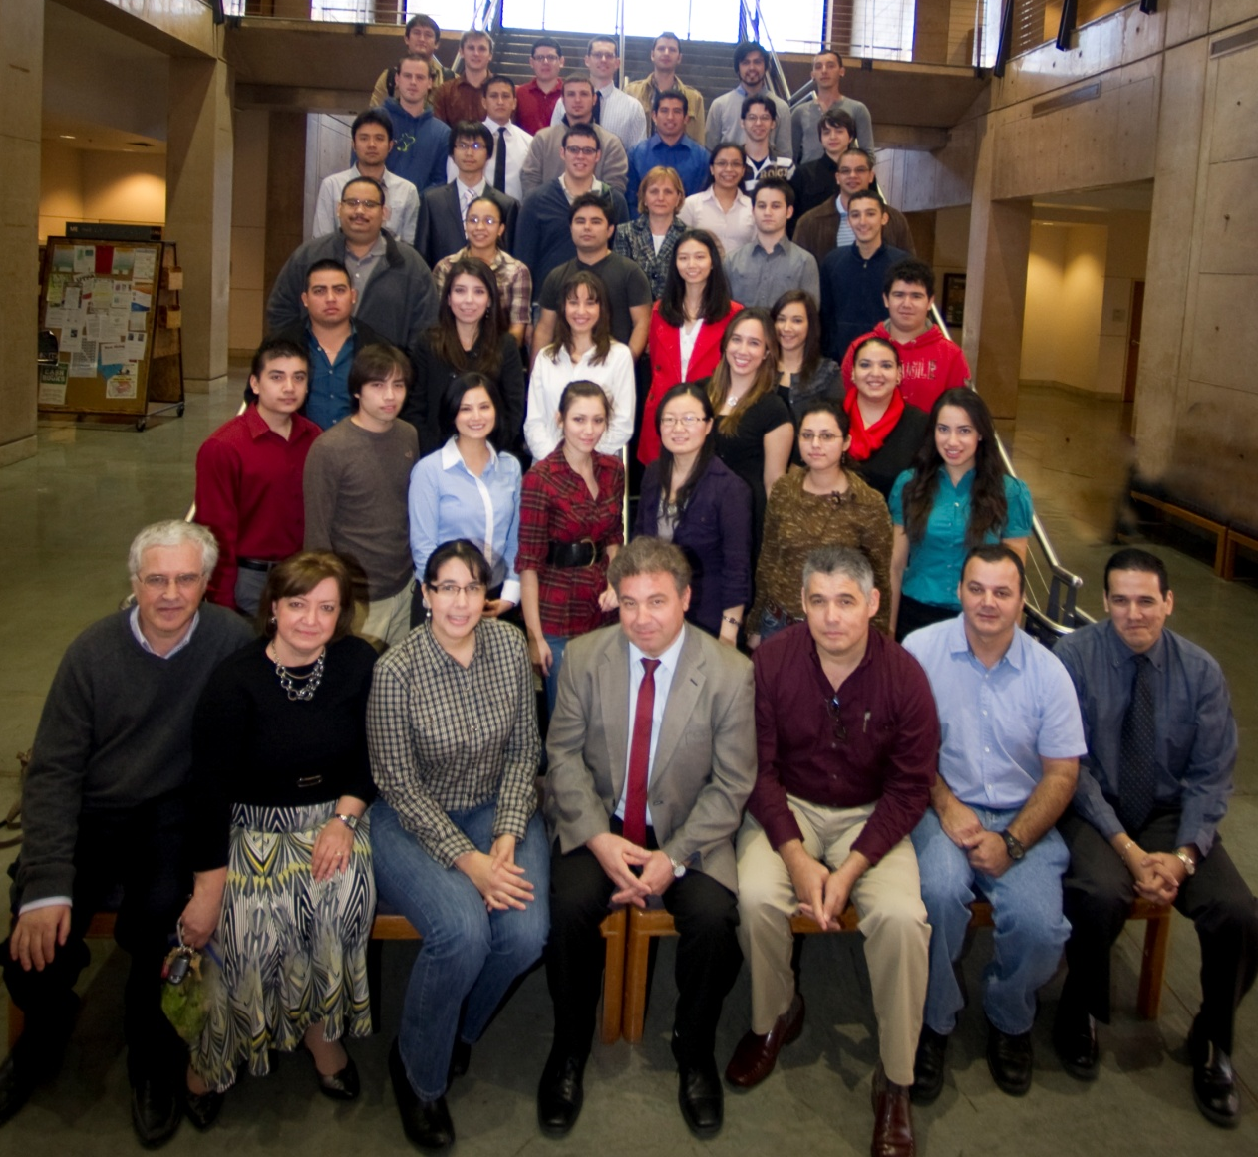
UTPA PREM Team
UTPA (non-PhD institution) serves >18,000 UG and MS students of which 47% are 1st-college generation and 88% are Hispanics.
The UTPA PREM program has 66% male and 34% female students participants. The average GPA of the participating students is 3.51.
Notes:
UTPA is located in rapid growing area in the Rio Grande Valley. The University continues to grow and is expected that by 2020 the student population will grow to almost 30,000 students. Almost half of the population is 1st college generation. The majority of the students work to support themselves and their families.

Slide 4
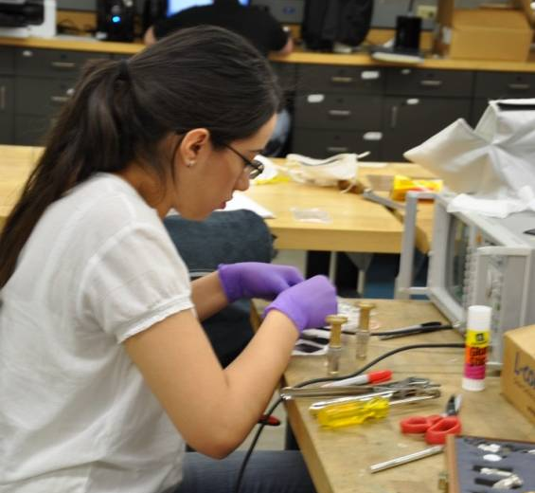
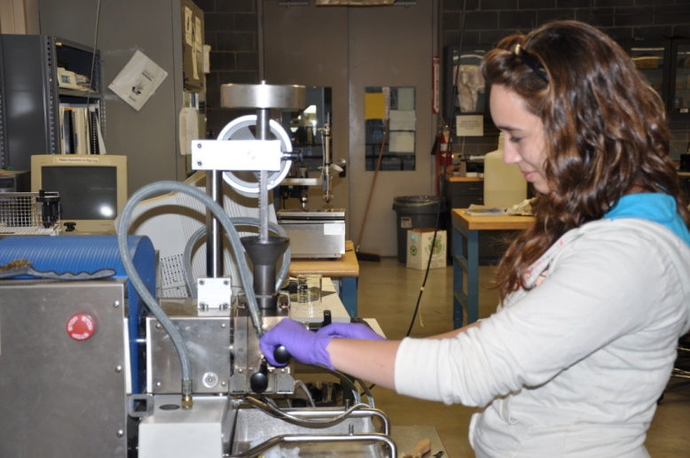
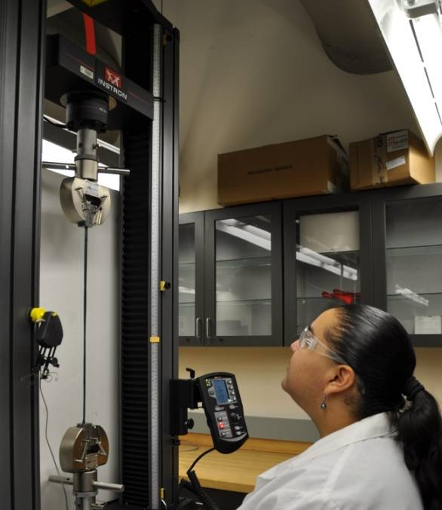
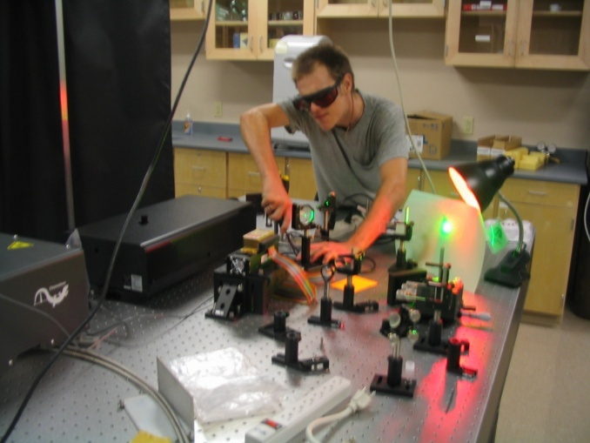
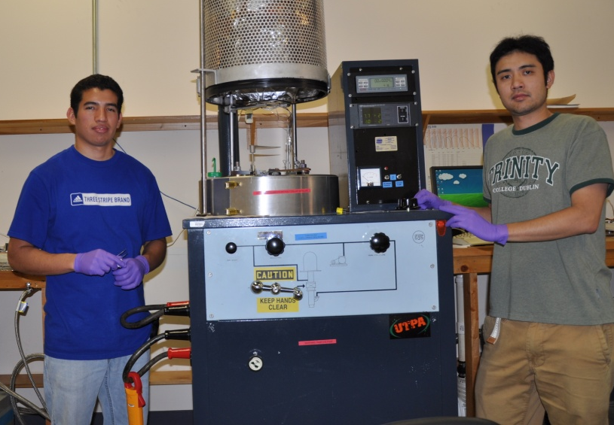
PREM Students in Cutting Edge Research Activities
Alma Perez, conducting
electromagnetic interference
shielding effectiveness analysis of
developed composites.
Samantha Salinas preparing
nanofiber reinforced polymer
composites.
Kris Ohlinger setting up for photonic
crystal development.
Getsi Vasquez evaluating
mechanical properties of
developed ductile composites.
Horus Garcia and Takashi Shimizu
experimenting with metallic vaccum
deposition on polymeric composites.
Notes:
Our students significantly benefit from research activities. Our program is designed to meet proposed research objectives, but also to increase student attraction to Mat. Sci. and engr. related degrees and the number of students attending summer research opportunities and graduate school, to improve perception of material science among other things.

Slide 5
PREM Student Recruitment & Engagement Key Activities
Background information
Student recruitment activities
Student research experiences & research seminar at UTPA
UTPA - REU participants and Faculty-Student Teams at UMN, & UTPA faculty and student visits to UMN Industrial Consortium (IPRIME)
UTPA-UMN joint research symposium, poster sessions, seminar speakers, webcast seminars at UTPA
Student involvement in outreach activities
Notes:
As Dr. Lozano pointed out, our PREM has specific objectives in terms of education and recruitment

Slide 6
Student Recruitment Activities
Undergraduate and graduate recruitment mainly occurs at the beginning of the academic year with involvement of most PREM faculty.
PREM team highly visible in STEM departments (e.g. shirts, posters, etc.) which promotes student interest and response.
Advertisement and recruitment starts in freshman courses.
Notes:
While most of the recruitment occurs at the beginning of the academic year, it is an ongoing effort that includes activities all year round.

Slide 7
Student Recruitment Activities
Recruitment process generally includes the submission of resume and an interview.
During probation period, most students start with 10 hrs/week.
After probation period, students are rewarded with full support (stipend or 15-20 hrs/week).
Usually PREM has a waiting list.

Slide 8
PREM Student Recruitment & Engagement Key Activities
Background information
Student recruitment activities
Student research experiences & research seminar at UTPA
UTPA - REU participants and Faculty-Student Teams at UMN, & UTPA faculty and student visits to UMN Industrial Consortium (IPRIME)
UTPA-UMN joint research symposium, poster sessions, seminar speakers, webcast seminars at UTPA
Student involvement in outreach activities
Notes:
The PREM students are usually the best promoters for the program. We focus in providing them quality experiences so they have many things to talk about.

Slide 9
Student Research Activities
Experiences designed to encourage and prepare students to pursue materials science careers & graduate school
(e.g. 5 out of 7 UG students that have graduated entered graduate school).
Safety and Instrumentation Training Workshop (at least one every semester).
PREM Faculty working primarily with UG students (e.g. students meet weekly with their respective advisors).
Notes:
Our program primarily focus on undergraduates students. Our

Slide 10
Student Research Activities
Students receive an interdisciplinary training to create a solid background for modern materials science.
UMN faculty and sponsored PhD students collaborate with UTPA faculty and students.

Slide 11
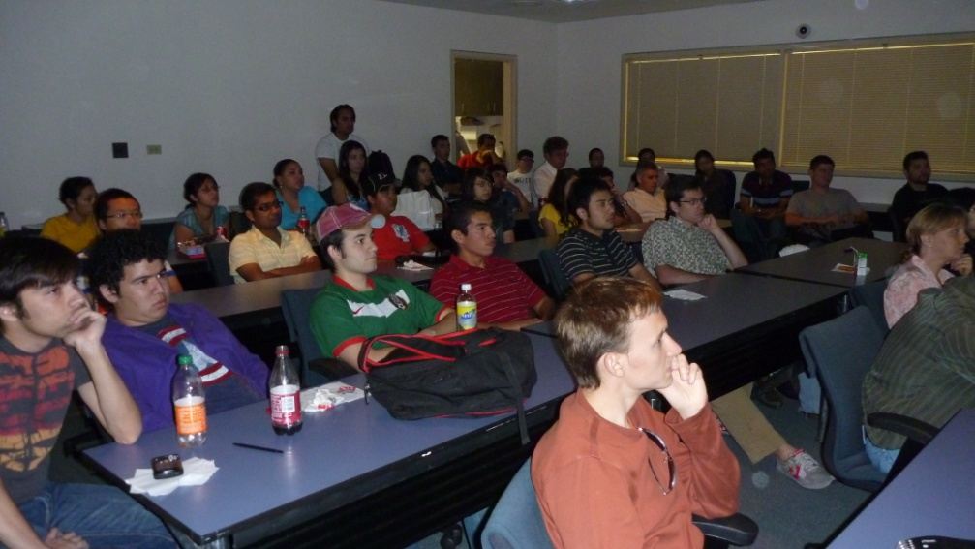
Research Seminar
Open student-based seminar designed to provide students objective feedback on the impact of their research participation and to develop technical communication skills.
Notes:
One of the key activities is an open student based seminar.

Slide 12
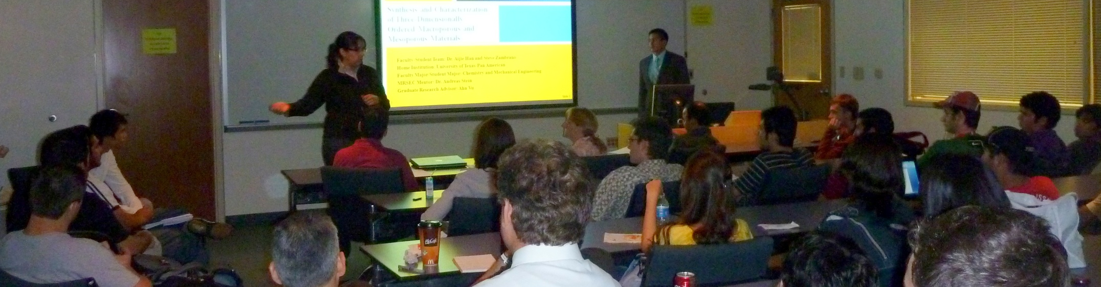
Research Seminar
Takes place every 3 or 4 weeks with 4 presentations from PREM students and faculty during the Fall and Spring semesters. (Note: every 2 weeks during the summer)

Slide 13
Research Seminar
Research skills sessions are also conducted during the research seminar.
Journal articles reading, understanding and writing sessions are also conducted.
Students also present their work in poster format at the end of the summer; the posters, as well as, the abstracts are compiled into an annual PREM booklet.

Slide 14
PREM Student Recruitment & Engagement Key Activities
Background information
Student recruitment activities
Student research experiences & research seminar at UTPA
UTPA - REU participants and Faculty-Student Teams at UMN, & UTPA faculty and student visits to UMN Industrial Consortium (IPRIME)
UTPA-UMN joint research symposium, poster sessions, seminar speakers, webcast seminars at UTPA
Student involvement in outreach activities

Slide 15
UTPA Visits to UMN Industrial Consortium (IPRIME)
In Spring 2010 & 2011, UTPA faculty and students traveled to UMN for IPRIME meeting.
Excellent opportunity to visit UMN, find out about other research projects, tour labs, and promote collaborations.
There are already more UTPA faculty and students interested in going to IPRIME.

Slide 16
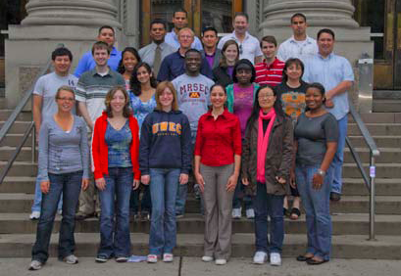
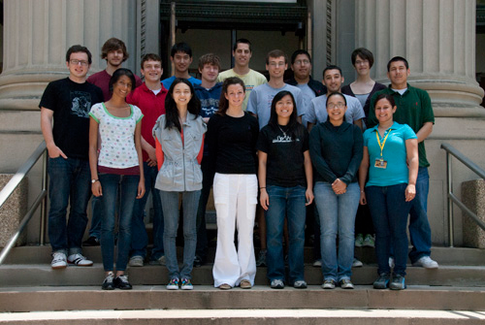
UTPA Students and Faculty at UMN Summer Program
Highly Successful
Student and faculty high level of satisfaction
Joint Publications

Slide 17
PREM Student Recruitment & Engagement Key Activities
Background information
Student recruitment activities
Student research experiences & research seminar at UTPA
UTPA - REU participants and Faculty-Student Teams at UMN, & UTPA faculty and student visits to UMN Industrial Consortium (IPRIME)
UTPA-UMN joint research symposium, poster sessions, seminar speakers, webcast seminars at UTPA
Student involvement in outreach activities
Notes:
As Dr. Lozano pointed out, our PREM has specific objectives in terms of education and recruitment

Slide 18
UTPA-UMN Joint Research Symposium & Poster Session

Slide 19
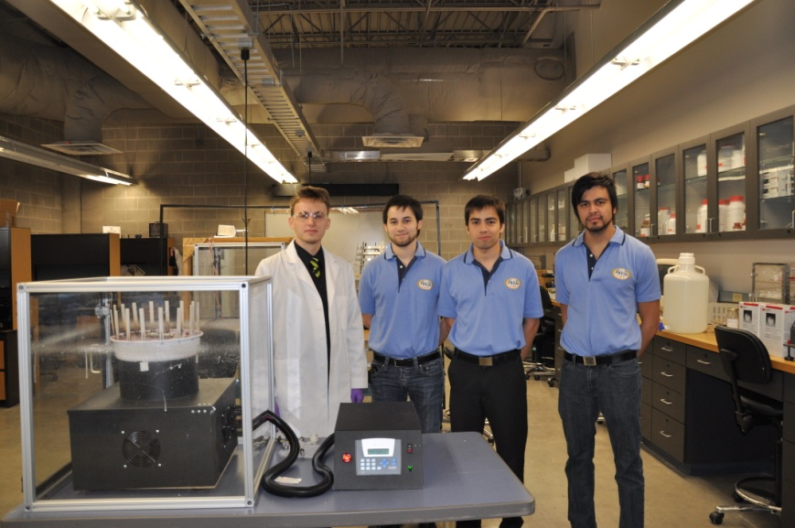
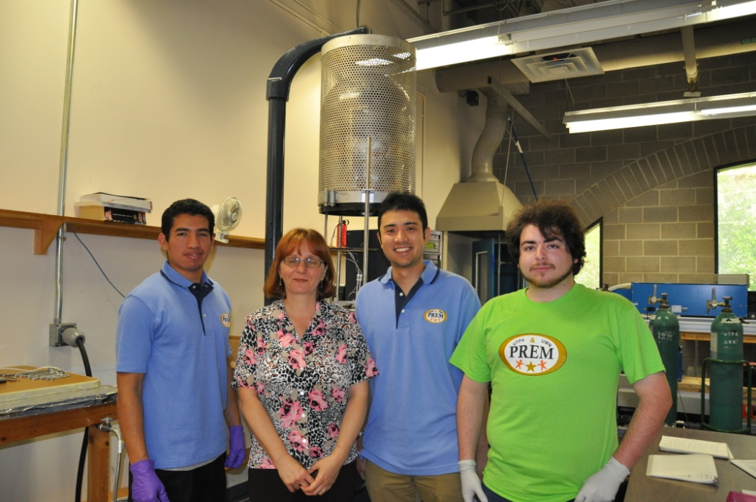
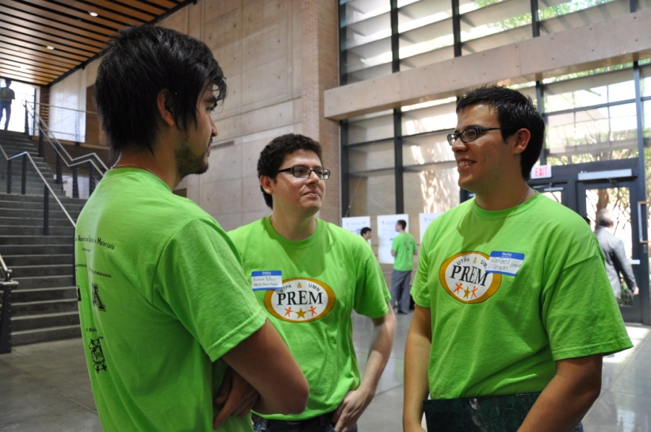
Seminar Speakers & MS committees at UTPA
UMN Presentations.
Joint Thesis Committees.
MRSEC webcast seminars.
UG Honors Thesis.

Slide 20
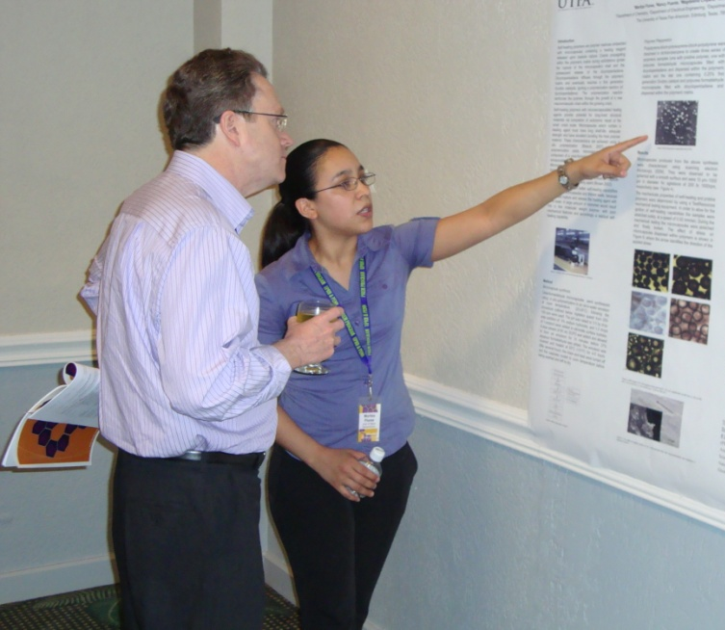
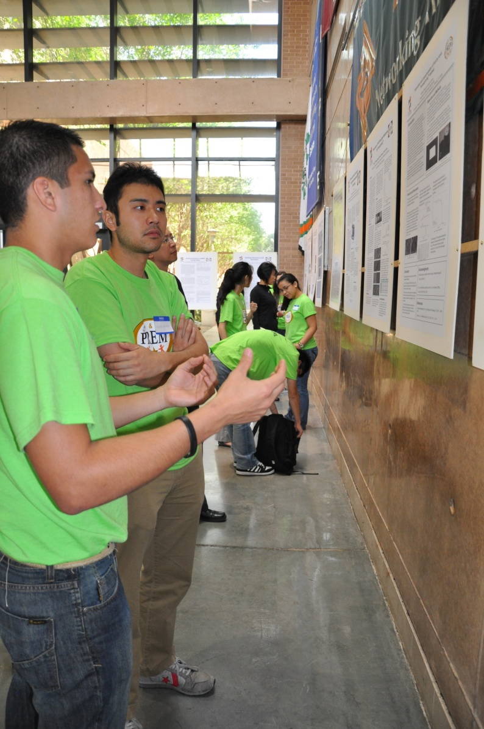
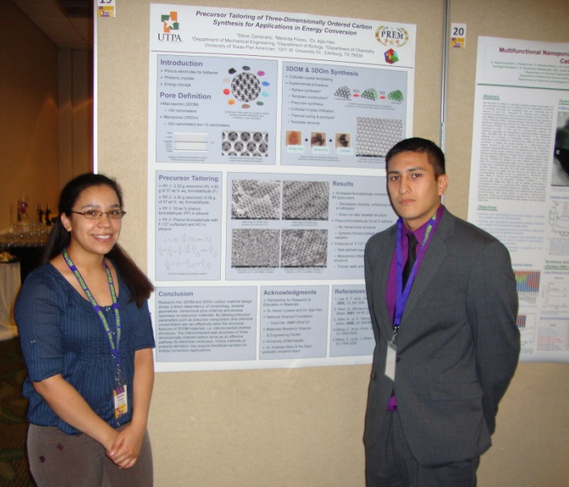
Poster Sessions
Notes:
We challenge our students to solve problems and provide public forums for the student to present their results and receive feedback. The challenge and public forum provide significant motivation to the student

Slide 21
PREM Student Recruitment & Engagement Key Activities
Background information
Student recruitment activities
Student research experiences & research seminar at UTPA
UTPA - REU participants and Faculty-Student Teams at UMN, & UTPA faculty and student visits to UMN Industrial Consortium (IPRIME)
UTPA-UMN joint research symposium, poster sessions, seminar speakers, webcast seminars at UTPA
Student involvement in outreach activities

Slide 22
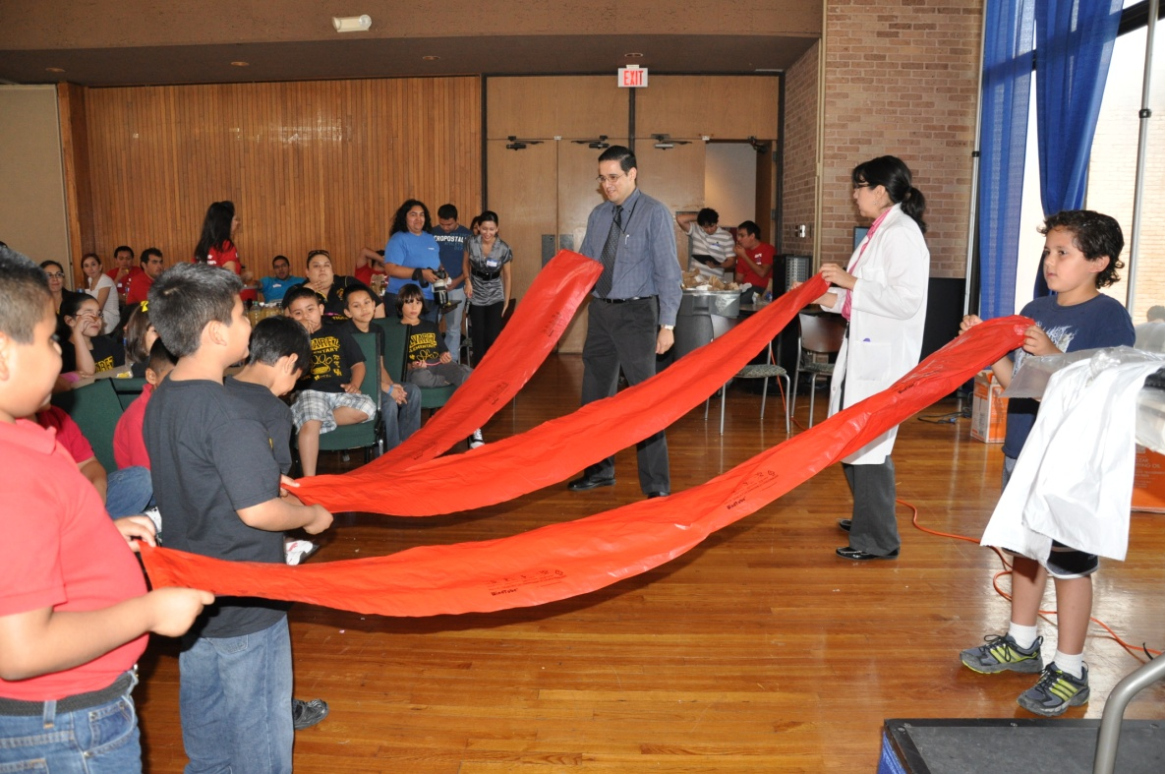
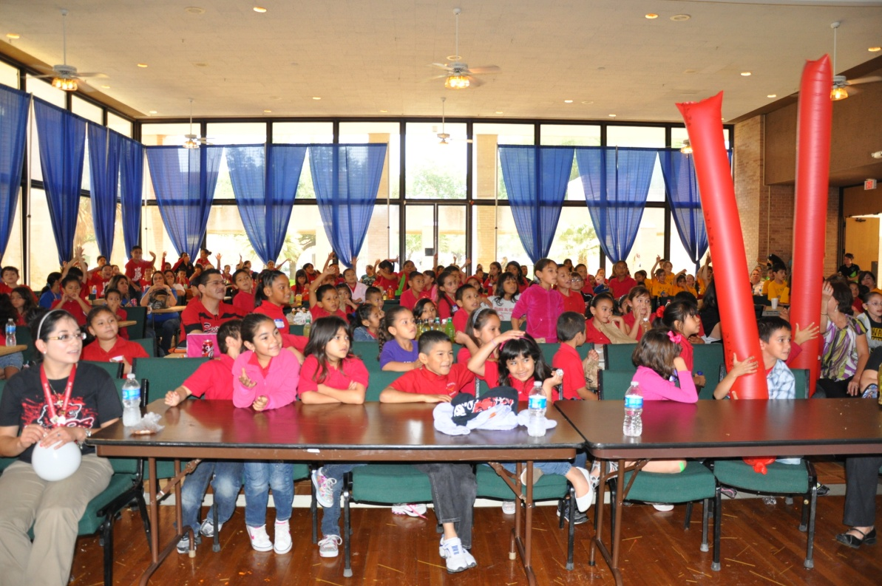
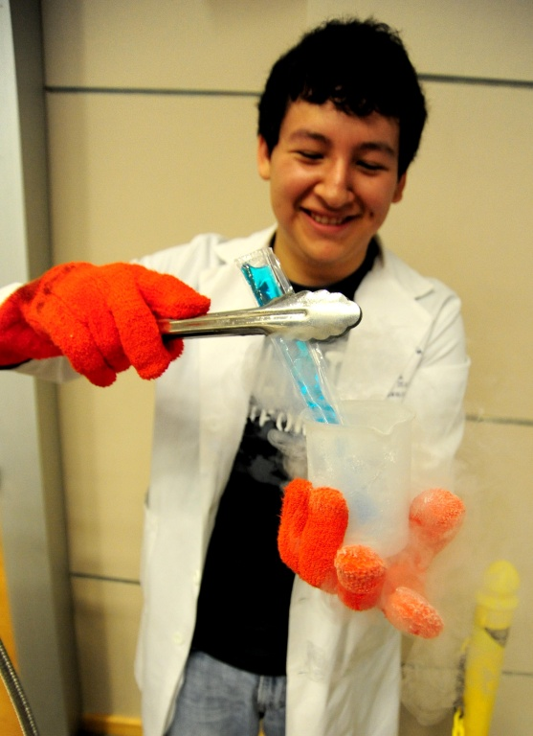
PREM Outreach Activities
PREM students and faculty are involved in presentations and facilities tours (e.g. during HESTEC community day)

Slide 23
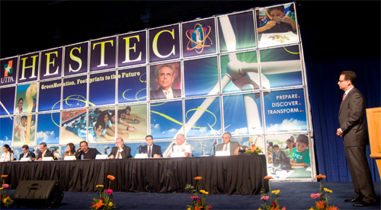
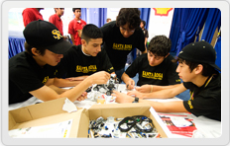
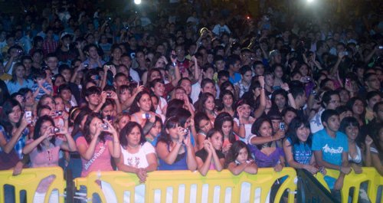
HESTEC
Hispanic, Engineering, Science, and Technology (HESTEC) Week is organized by UTPA early in the fall semester to address the critical shortage of scientists and engineers in the US.

Slide 24
Final Remarks
Create Synergy and Use the Leverage from other Activities.
Adapt to Student Needs.
Build Strong Sense of Community.
Challenge, Help Students Access and Organize Knowledge, Assess, and Provide Feedback (e.g,. public forums).
Promote High Standards and Reward Accomplishments.

Slide 25
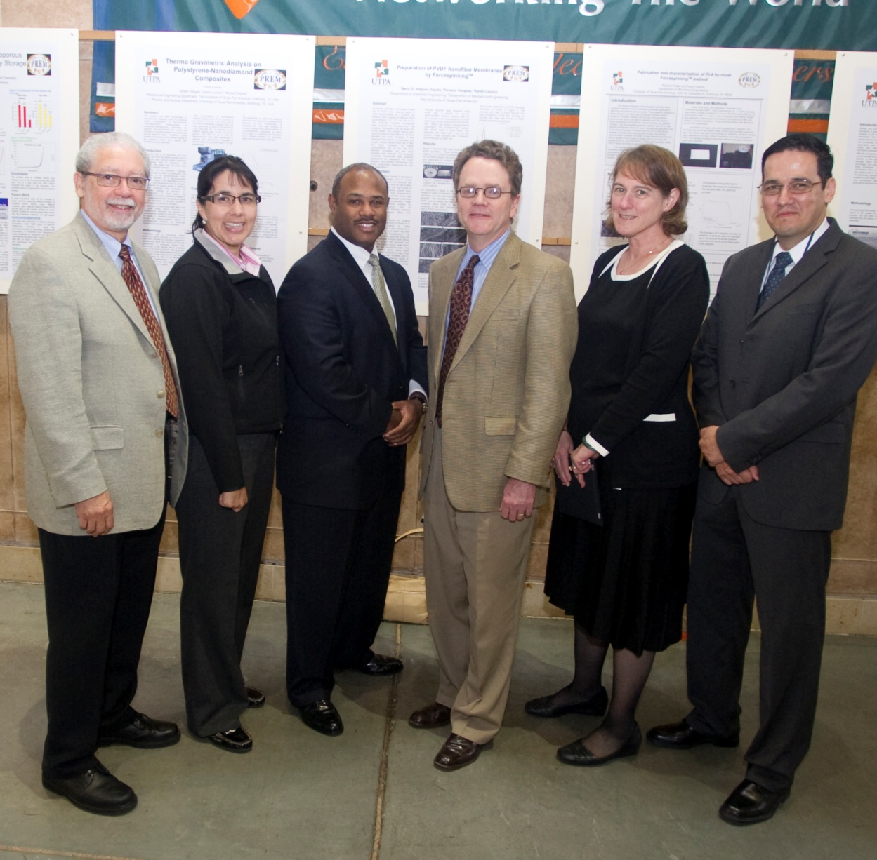
Thank YOU

Slide 26
Open Forum

Slide 27
Sample PREM Evaluation Results
45% and 31% of the participants declared that their main educational goal is to obtain an M.S. and Ph.D. degree respectively. The previous year 60% and 10% of PREM students were interested in M.S. and Ph.D. degrees respectively.
Recruitment efforts are being redirected to freshman, sophomore, and junior students.

