Slide 1
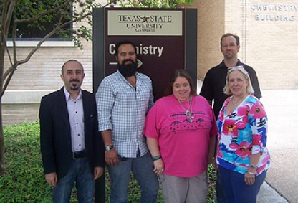
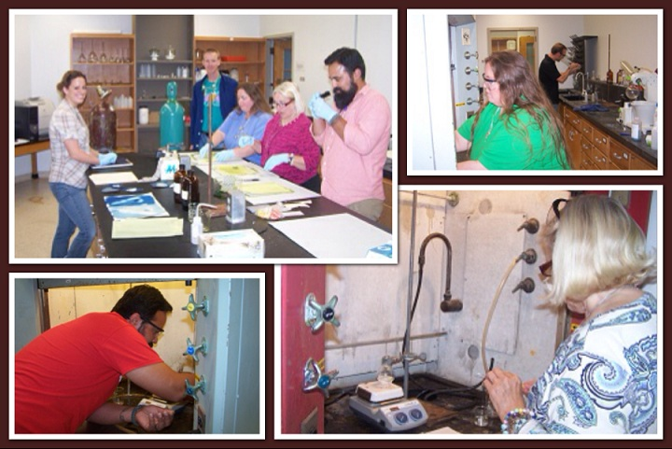
Texas State University PREM: Center on Interfaces in Materials. A Partnership with the Research Triangle MRSEC
2013 PREM Academy for High School Teachers
Beall, Martin, Brittain, Gulacar & Whitten
Texas State University
The PREM Academy is a teacher/PREM researcher workshop - Goals:
Address critical deficiencies in experiential learning through hands-on laboratory exercises with PREM faculty
40 hour training program
Expose local educators to current materials research
Introduce Project Based Instruction to enhance greater inquiry and depth
Collaborative development of freely available activities for the classroom
Training in Legacy Cycle to comply with Texas Essential Knowledge and Skills standards
Three teachers from San Marcos High School participated in the 2013 PREM Academy
Hands-On Laboratory Topics
Natural Nanoparticles
Characterization of Biomaterials by Chromatography
Sol-Gel Chemistry
Photochromism
DMR-1205670

